Slide 1
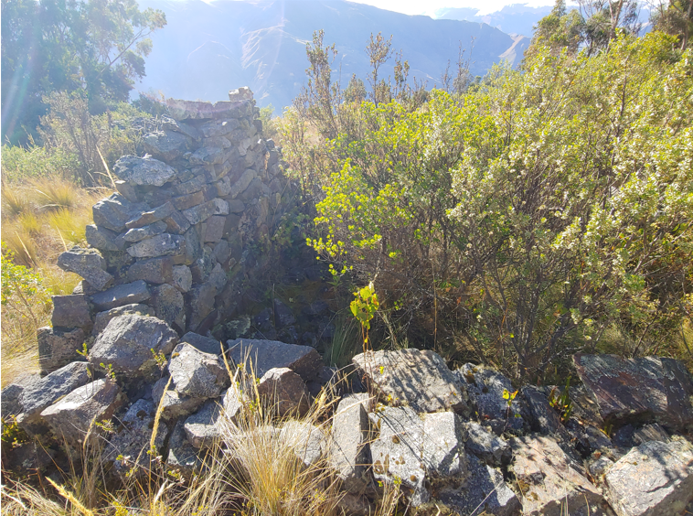
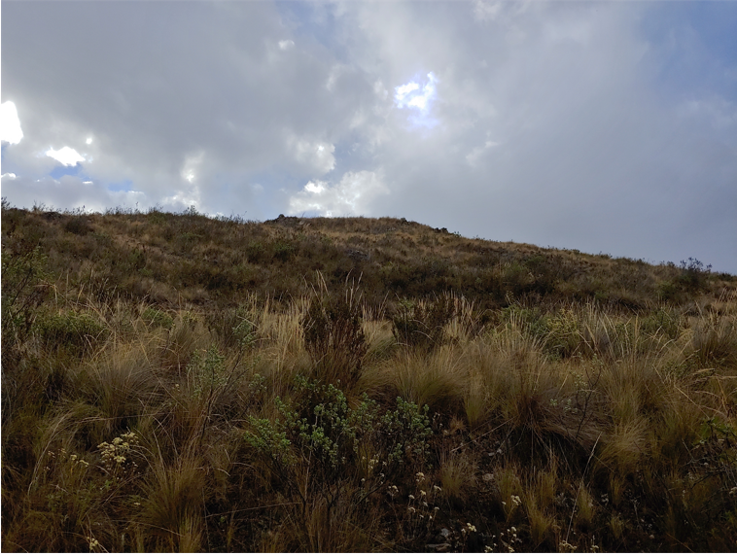
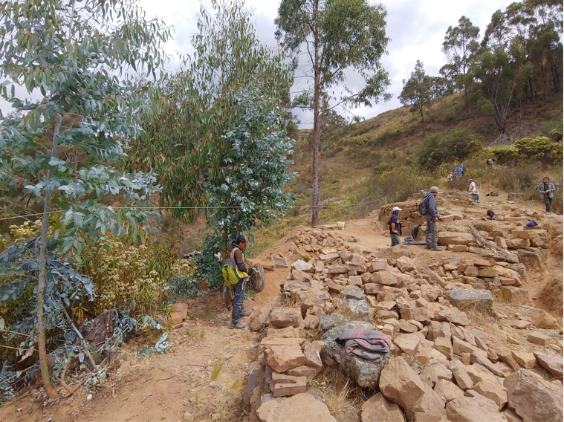
RECUAY MORTUARY ENTANGLEMENTS IN HIGHLANDS ANCASH, PERU Dominic Greenlee

Slide 2
Testable Hypotheses
Social Differentiation
Ability to manifest relative wealth or status
Mortuary monuments
Most visible manifestation of social change
Foreign cultural influences
Foreign prestige goods
Archaeological Heterogeneity
Dispersed Settlement Patterns
Major cities, villages, hamlets
Cultural Change over time
Increased access to trade after AD 500
Eventually Wari incursions after AD 700

Slide 3
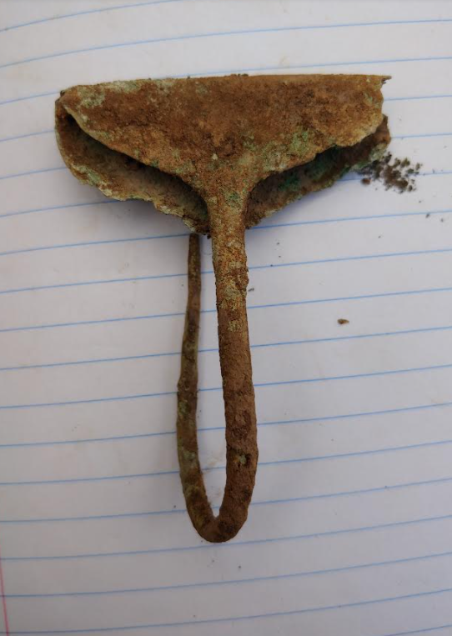
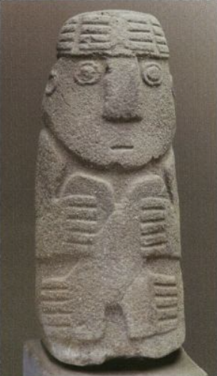
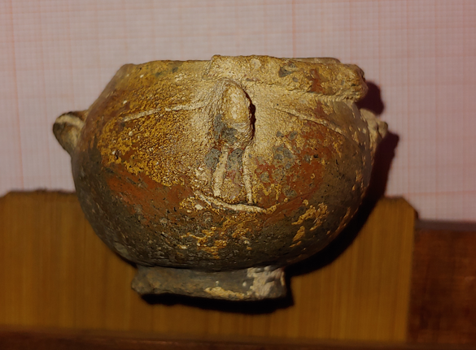
Recuay Ancestor Veneration
Recuay Tradition of Ancestor Veneration
Public feasting episodes
Public and familial mourning
Mallqui bundles in flexed positions
Accessible remains
Ongoing sacrifices to ancestors
Lithomorphosis
Dead become a revered ancestor
Revered ancestors become stone
Some holdover tenon-heads from Chavin
Wari additions to the Ancestor Veneration
Smaller patios for smaller feasting
Chullpas
Tupu Pin from Chullpa 3 Coronajirca site near Huari
Recuay Stone Effigy of a Mallqui bundle Museo Arqueologico de Ancash, Huaraz.
Grave offering micro-ceramic from Chullpa 3 Coronajirca in Huari

Slide 4
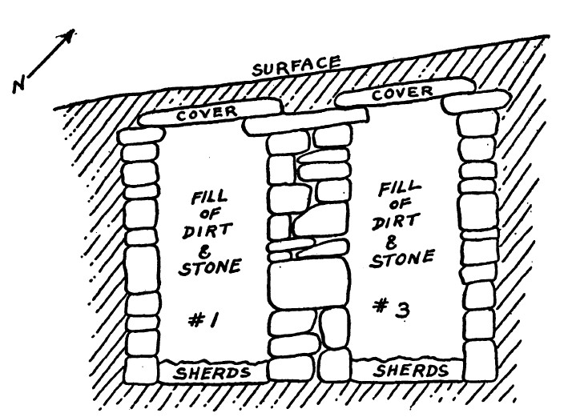
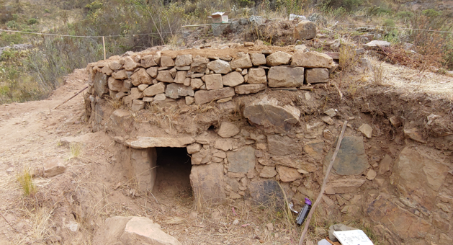
Recuay Mortuary Architecture
Lined Graves
Stone boxes beneath boulders
Fewer status goods or ceramics
Often good preservation
Unlined Graves
Generally natural overhangs or caves
Limited grave goods of any kind
Animal offerings
Subterranean Galleries
Common in larger sites
High volume of grave goods
Very similar to Chavin culture
Finest masonry at the time
Cist burial (deep stone-lined)
Rectangular or cylindrical
Well preserved ceramic assemblages
Chullpas (after AD 500)
Semi-subterranean
Defined entrances
High volumes of grave goods
Some “mega-Chullpas”
Deep Stone-lined Bennett’s excavation of Wilkawain in 1944
Chullpa 1 from Coronajirca, Huari

Slide 5
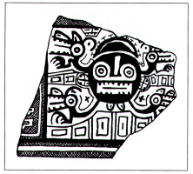
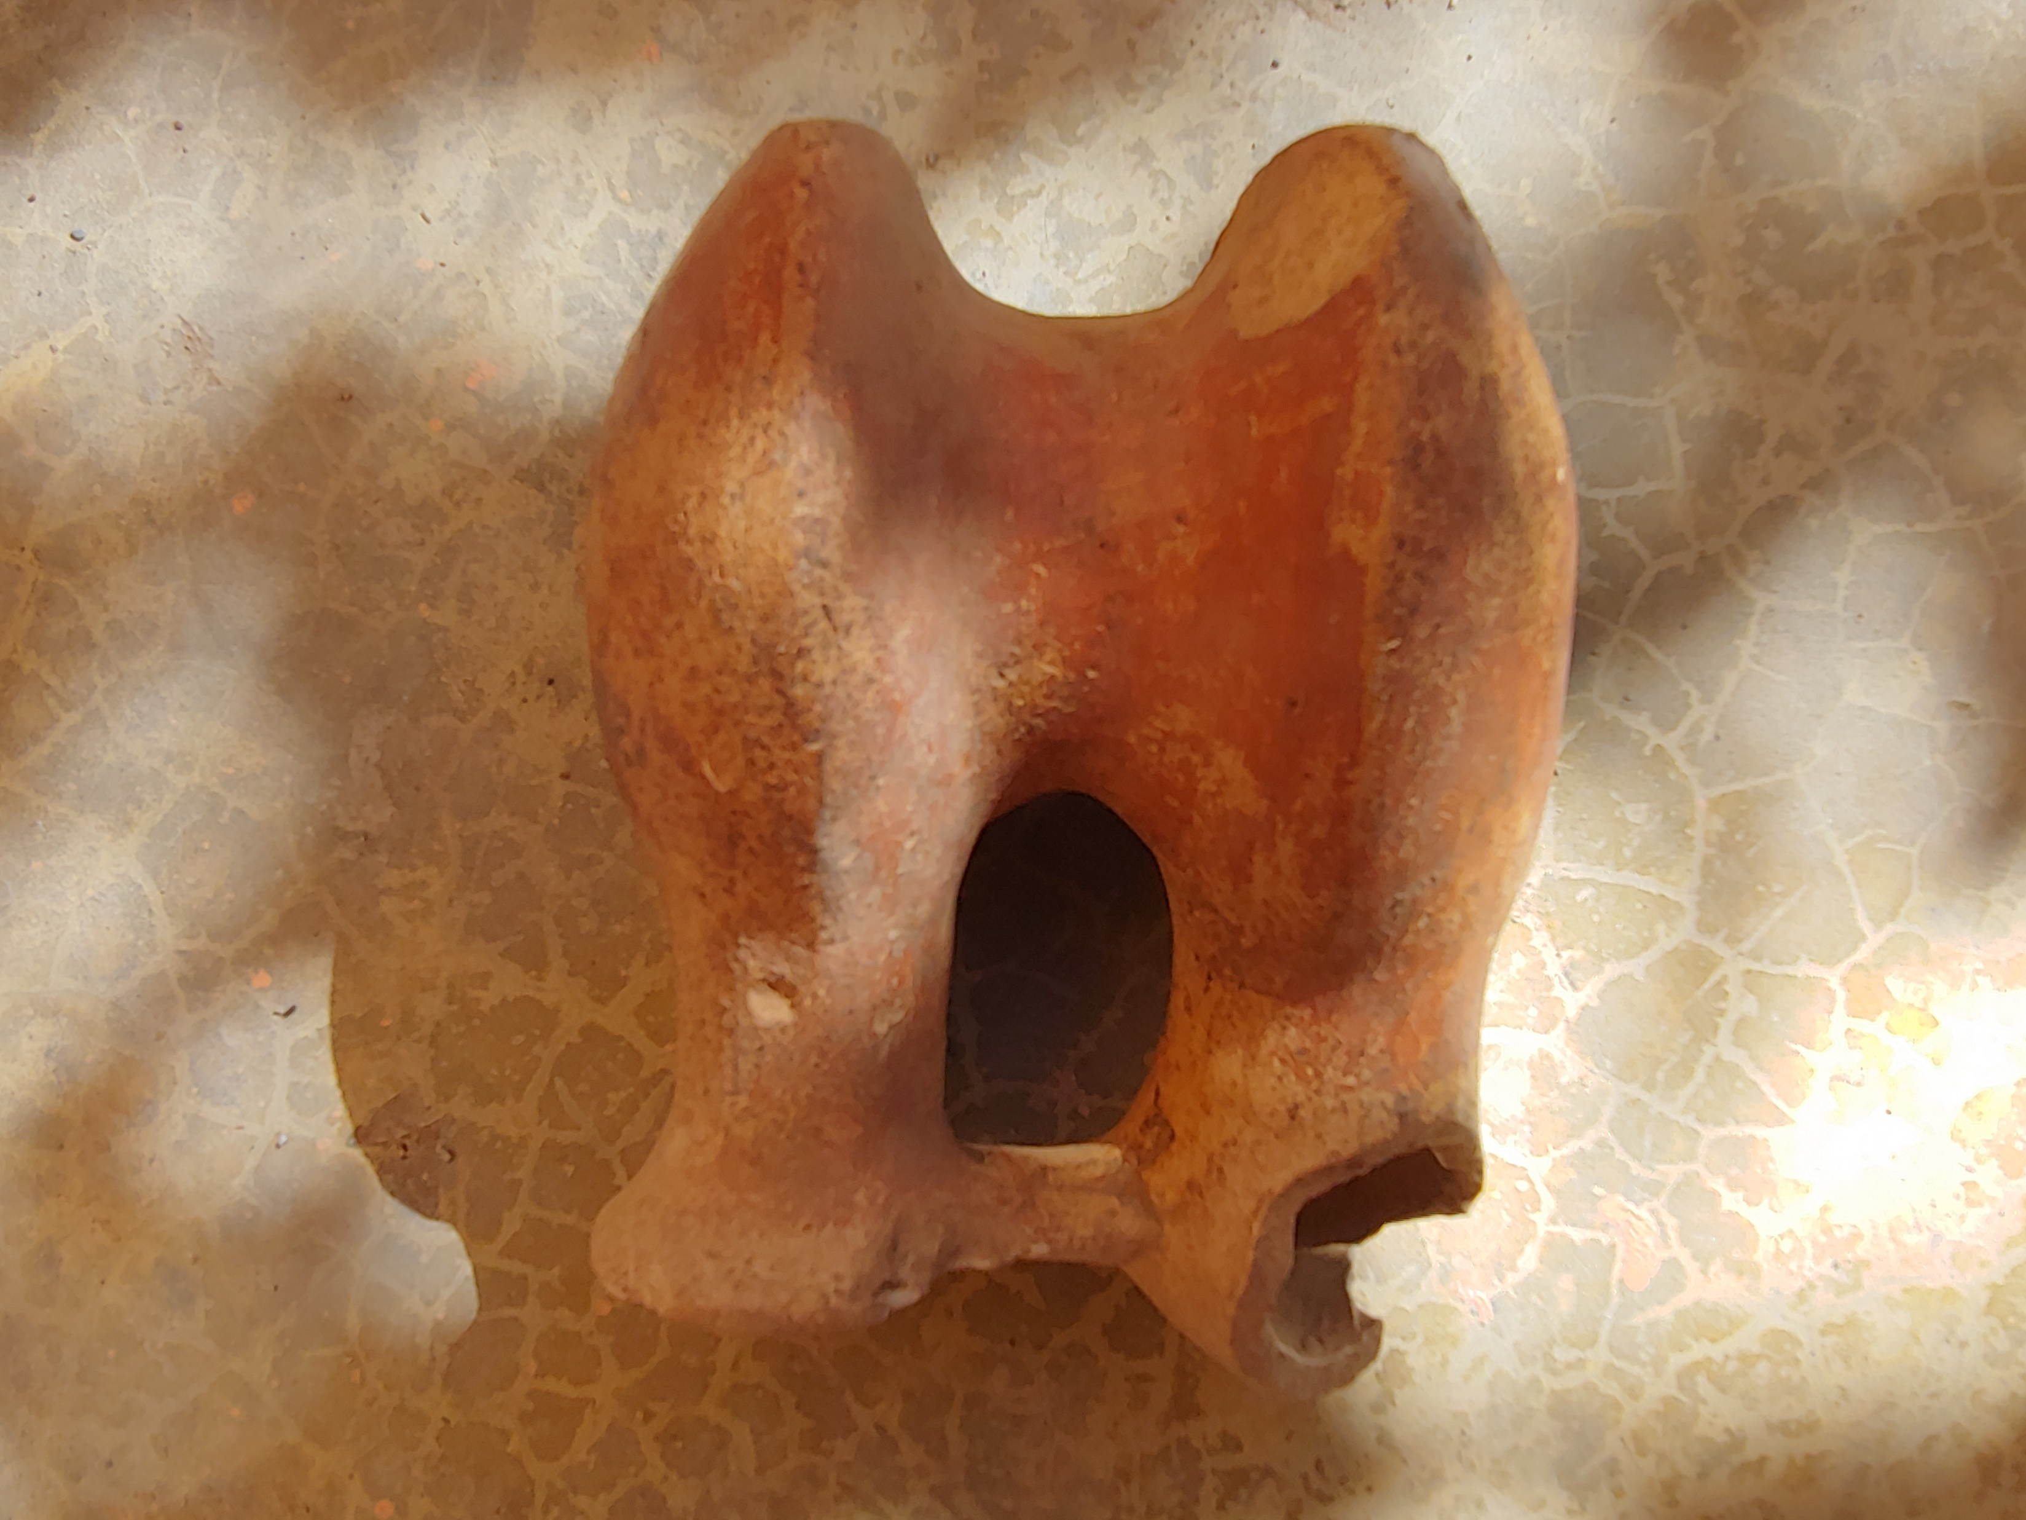
Recuay Exchange Networks
From the highlands
To the highlands
Kaolin
Wool
Coca
Shared Moon Animal and motif
Moche Ceramics
Spondylus shell
Lambayeque ceramics
Lima and Nasca ceramics
Obsidian
Wari Cultural Bundle
Increased obsidian
Wari Ceramics
Chullpas
D-Shaped Patios
Head with emanations, sherd 12/7 from Grieder 1978:139.
Chulllpa 5 from Coronajirca Recuay vessel

Slide 6
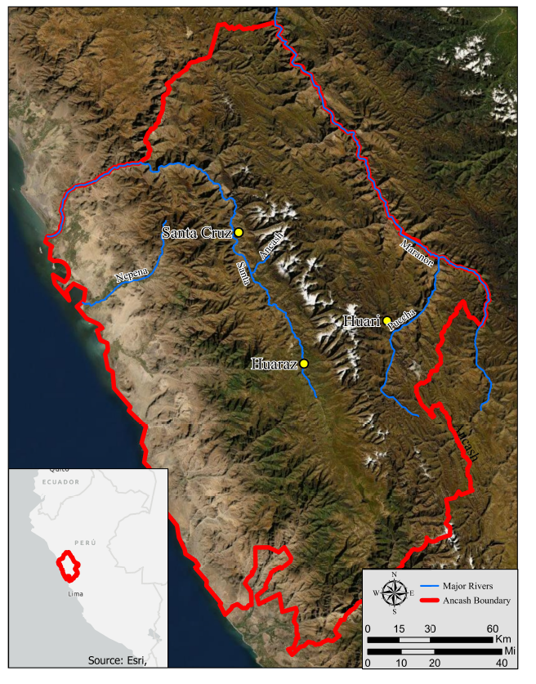
Dataset Construction
Data Sources
Dissertation near Santa Cruz under Bria
Thesis from Rio Ancash by Barbosa
Thesis from Huaraz by Ponte
Work in Rio Puccha by Ibarra
Pull it together in a common dataset
Format the dataset for my questions
Mortuary architecture
Ceramic volume and type
Metal volume only
Presence of individuals
Breakdown of the MNI
Focus on reuse and longevity

Slide 7
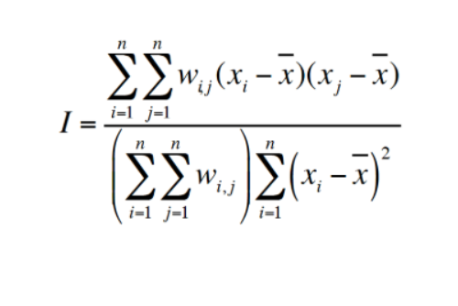
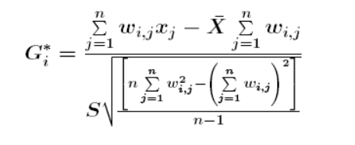
Test Sequence
Spatial Clustering Tests
Moran’s I
Autocorrelation tests
a test on spatial variance
Points have like values
Getis’ Gi
Generates spatial clusters
Nearest neighbor P-test
Clusters of high and low values
Outliers generated for both
ID; presence of burials; presence of ceramics; Ceramic Type; presence of metal; MNI
Qualitative for Chullpas
Show locations of chullpas
Display as a pie chart of treatment

Slide 8
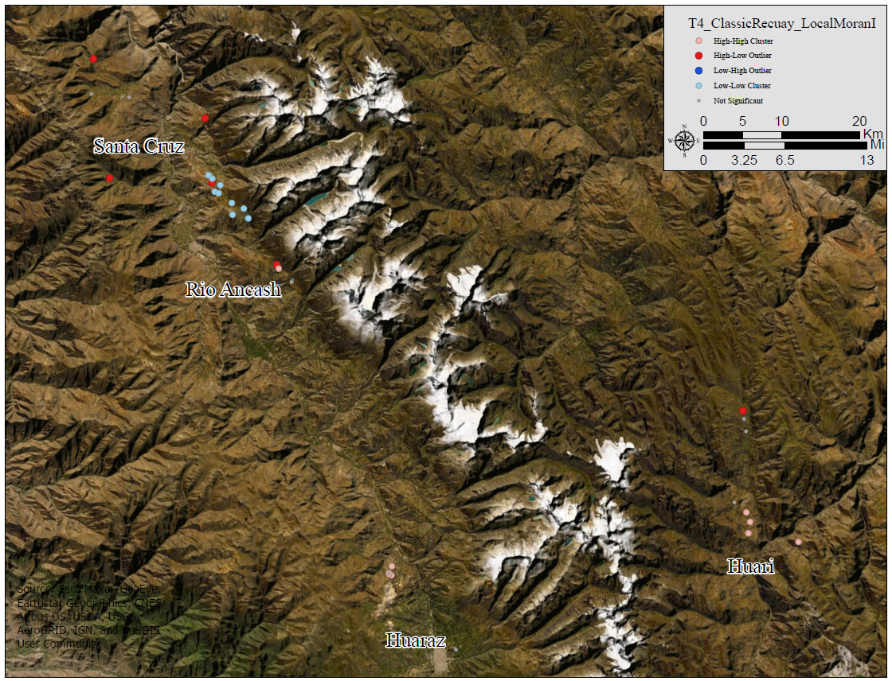
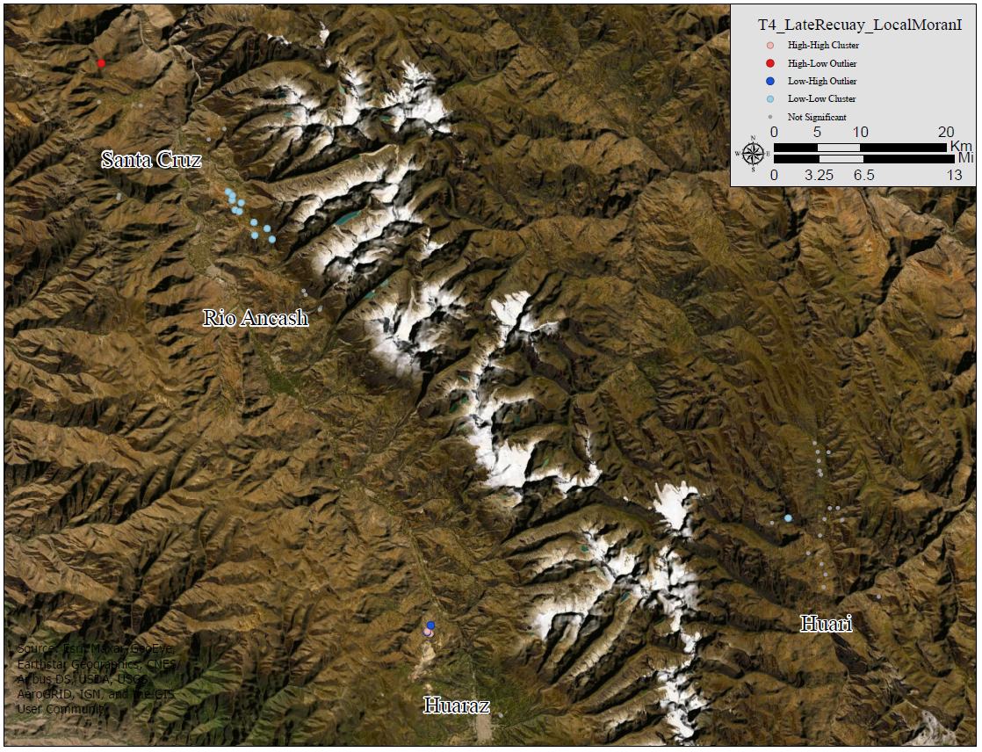
Trial 4 Ceramics Coded
Figure 5.6 Trial 4 Local Moran’s I for the Classic Recuay era
This map shows the results of the local Moran’s I during the Classic era. Note the low-low clustering surrounded by high-low outliers in Santa Cruz, the high-high cluster around Huaraz and Huari, and the outliers along the Río Ancash.
Figure 5.8 Trial 4 Local Moran’s I for the Late Recuay era
This map shows the results of the local Moran’s I during the Late Recuay era. Note the low-low cluster around Santa Cruz and the high-high cluster around Huaraz.

Slide 9
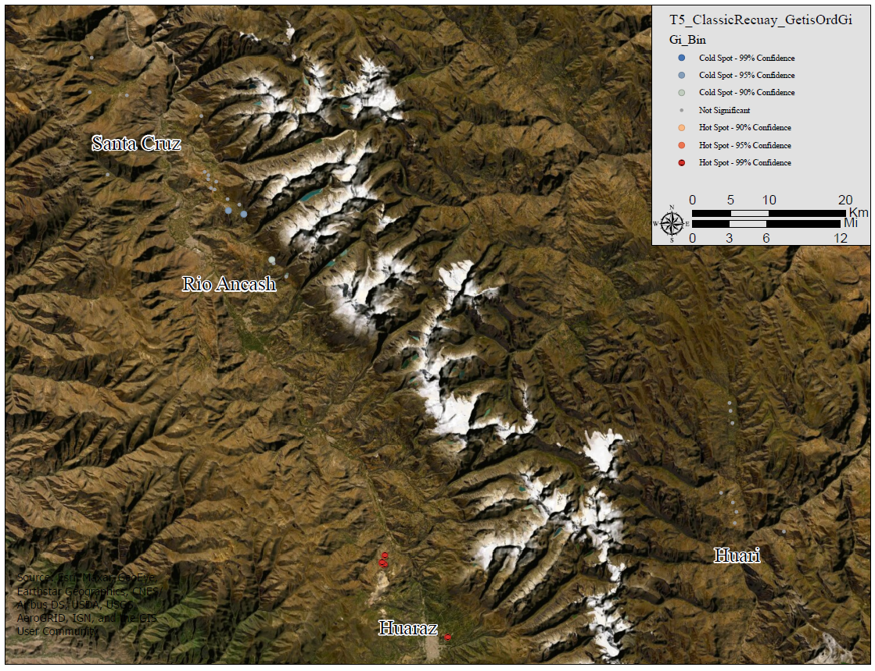

Trial 5 Metal Presence
Figure 5.11 Trial 5 Local Getis Gi for the Classic Recuay era
This map shows the local Getis Gi for the Classic Recuay era. Note the coldspot around Santa Cruz (95% confidence) and the hotspot near Huaraz (99% confidence).
Figure 5.13 Trial 5 Local Getis Gi for the Late Recuay era
This map shows the local Getis Gi results during the Late Recuay era. Note the coldspot near Huari (95-99% confidence) and the hotspot near Huaraz.

Slide 10
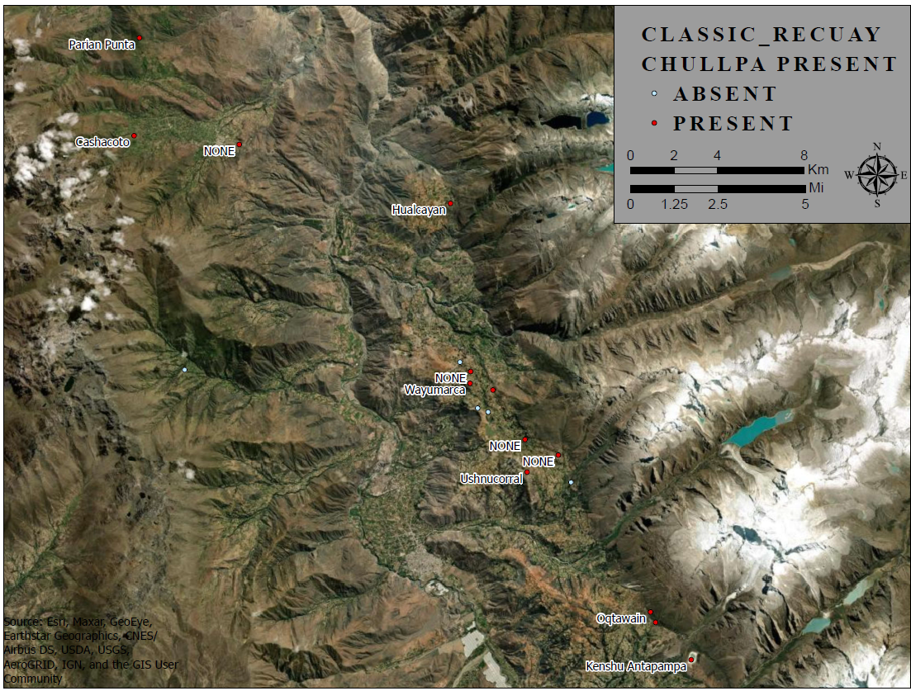
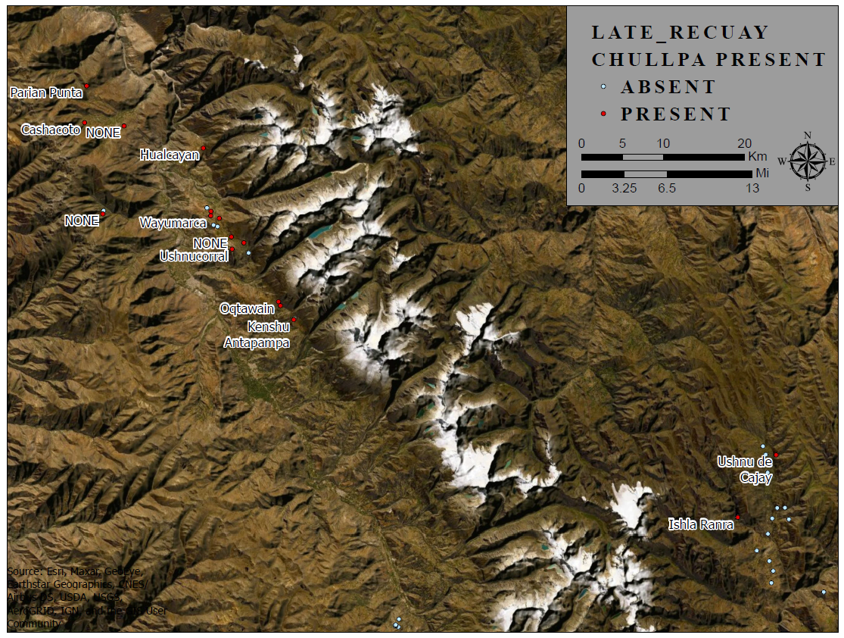
Qualitative Mortuary Monuments Assessment
Figure 5.15 Chullpas present during the Classic Recuay Era
This map shows the distribution of chullpas among sites occupied in the Classic Recuay era.
Map 5.16 Chullpas Present in the Late Recuay Era
This map shows the distribution of chullpas among sites occupied during the Late Recuay era. This is the beginning of chullpa building in Ancash.

Slide 11
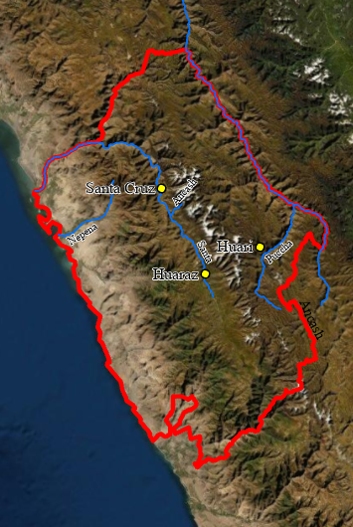
Dataset Discussion
Huari sites are Recuay Hinterland
Few prestige goods present
Few trade goods present
Few sites occupied past AD 700
Huaraz sites are hinterland but Callejon
Higher concentration of metalwork
Few trade goods present
Some sites occupied past AD 700
Rio Ancash closer to the trade routes
High concentration of Chullpas
Fewer early cave and subterranean burials
Kaolin and Akillpo ceramics present
Santa Cruz closest to coast
Huge variability in the sites present
Clear cultural change as a result
Changes in ancestor veneration with Chullpas arrive

Slide 12
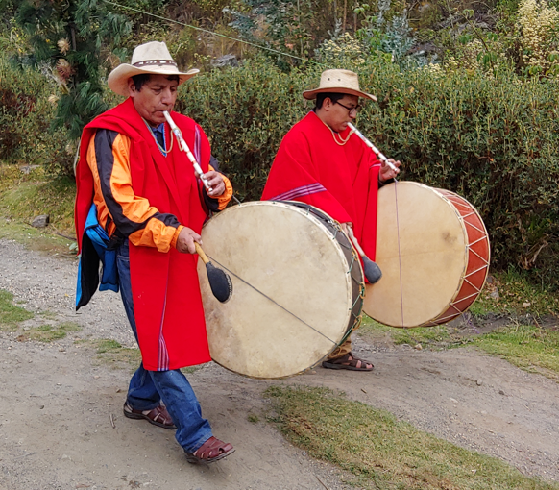
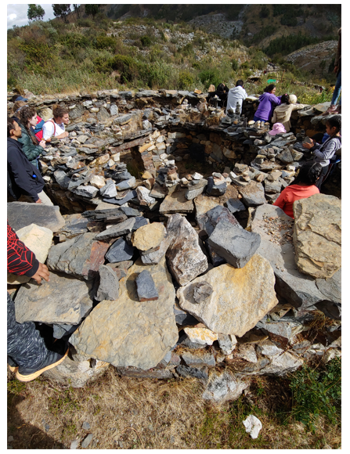
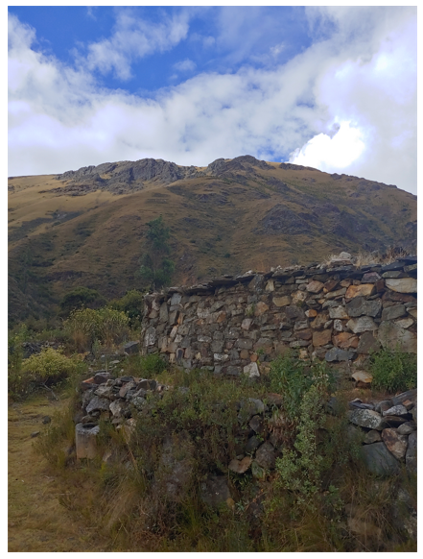
Outliers as data
Outliers are distinct from local clustering or hotspots
Confluence of traits at sites
Outliers tended to be outliers across trials
Outliers can be multi-component cities
Cruz Punta, Hualcayan, Quitapampa
Outliers can be isolated sites
Ama, Ogupampa
Outliers can be anomalies
Laguna Purhuay locality
Llamacorral and Ishla Ranra
Modern Procession towards Laguna Purhuay during the Ecotourist festival
Llamacorral site
Llamacorral with Ishla Ranra in the distance

Slide 13
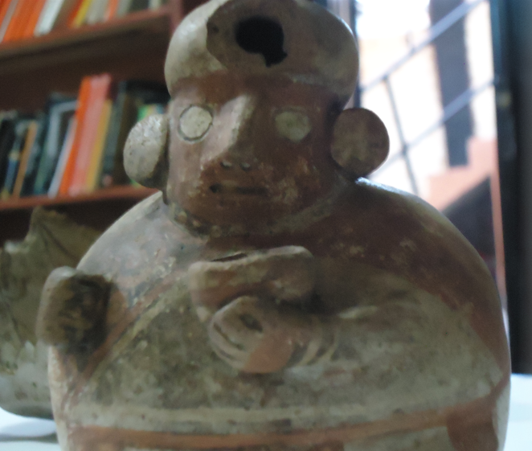
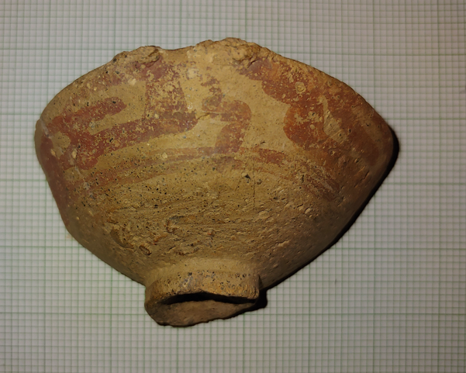
Social Differentiation Conclusion
Recuay elites demonstrated social status
During life in public ceremonies
Ancestors venerated by their kin after death
Tombs and burial goods
Tendency toward kaolin fineware
Foreign made status goods
Increase in foreign goods after AD 500
Increased visibly in status goods
Commonly in Santa Cruz and Rio Ancash
Closer to the heartland networks
More Chullpas present
Marca Jirka near Huaraz
Local elites with local wealth expressions
Effigy Cup Huari-Ancash collection
Recuay Ceramic from Chullpa 5 Coronajirca

Slide 14
Archaeological Heterogeneity Conclusions
Wide distribution of Recuay manifestations
Many small local central places
Many local elites mobilize labor
Clustering tests showed heterogeneity
Global statistics not significant at .05
The data is not clustered or dispersed
Local statistics showed significance
Dispersed significant clustering
Strong pull locally affects global data
Huari shows local clusters

Slide 15
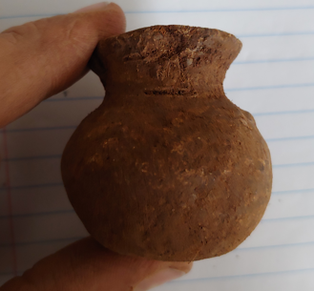
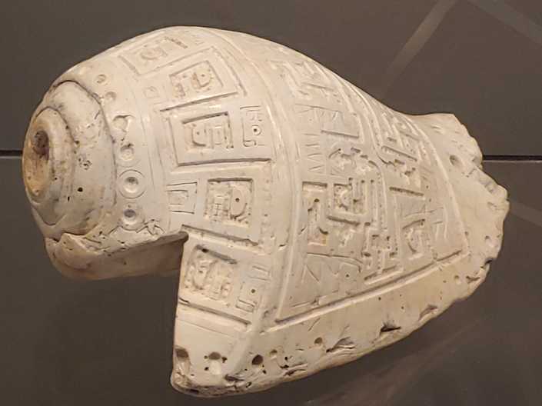
Cultural Change Conclusions
Choices made by elites are proxies for social changes
Importation of foreign status goods marks change
Never population supplantation but diffusion
Hualcayan is a city with several visible transformations
Wari bundle was less prominent
Minimal Wari era ceramics
Still visible in the Chullpa distribution
Commonly in the Rio Ancash
Heartland visible in the hinterland
Face Pot from Chullpa 3 Coronajirca
Ornate Spondylus shell from Chavin museum

